Slide 1
Auto-regressive Generative Models
Lecture 8
Part 2
Generative AI for Computer Vision

Slide 2
Content
Autoregressive Model
Fully Visible Belief Network (FVBN)
Pixel CNN
Pixel RNN

Slide 3
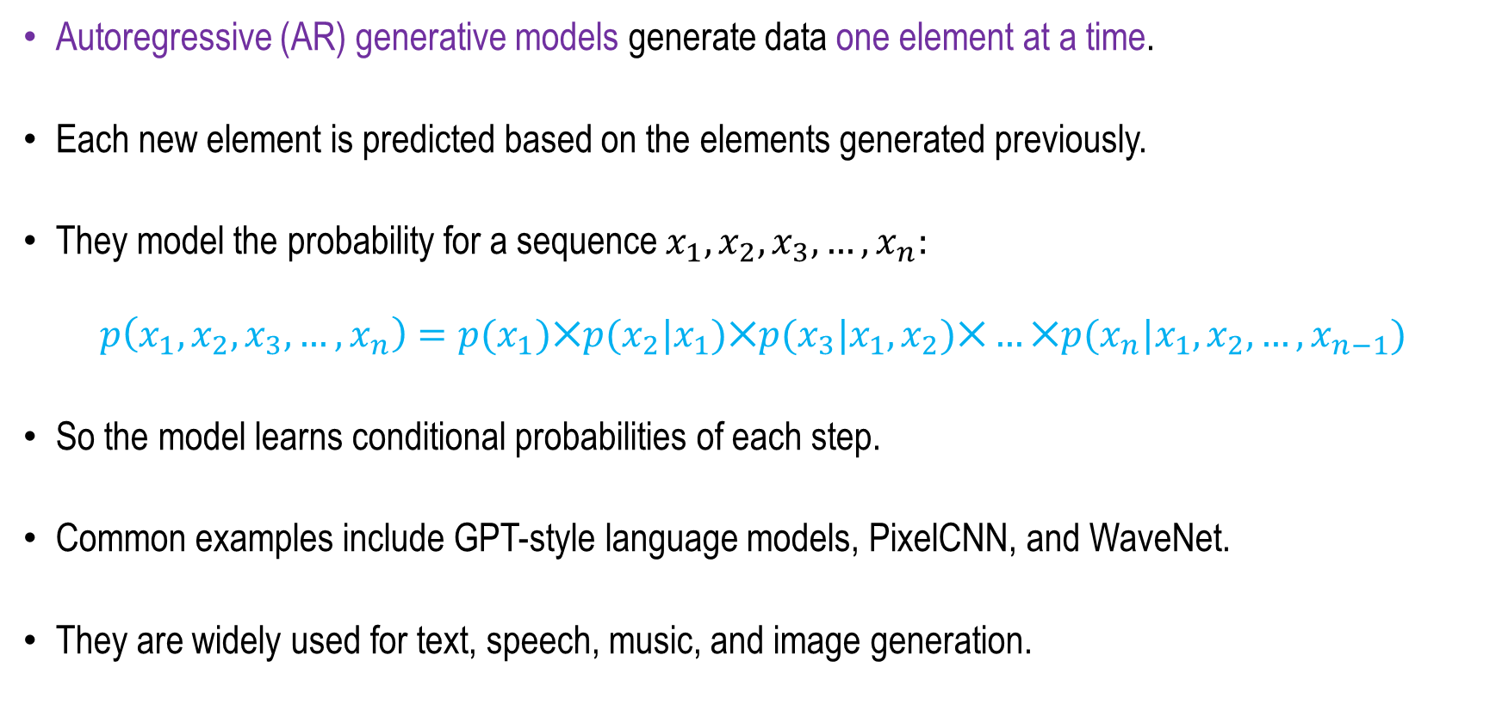
Autoregressive Generative Model
Autoregressive (AR) generative models generate data one element at a time.
Each new element is predicted based on the elements generated previously.
They model the probability for a sequence $x_{1}, x_{2}, x_{3}, …, x_{n}:$
$$p\left(x_{1}, x_{2}, x_{3}, …, x_{n}\right)=p(x_{1})⨉p(x_{2}|x_{1})⨉p(x_{3}|x_{1},x_{2})⨉…⨉p(x_{n}|x_{1},x_{2},…,x_{n−1})$$
So the model learns conditional probabilities of each step.
Common examples include GPT-style language models, PixelCNN, and WaveNet.
They are widely used for text, speech, music, and image generation.

Slide 4
How Autoregressive Image Generation Works
The model receives an initial input or prompt. It predicts the probability distribution of the next element/token.
One token is selected from this distribution. The selected token is added to the sequence.
The process repeats until the desired output is generated.
Example:
Input: “The cat is”
  Model predicts: “sleeping”
  “The cat is sleeping”
  predicts the next token
  continues until the sentence is complete.

Slide 5
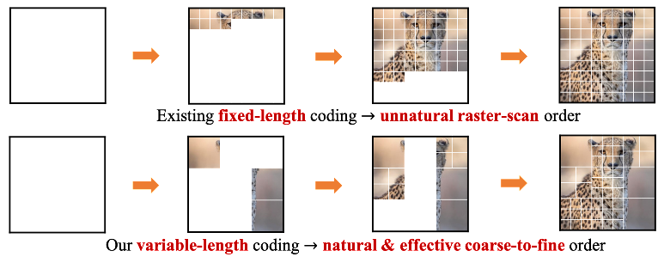
How Autoregressive Image Generation Works
An image is converted into a sequence of pixels, patches, or tokens.
The model observes the previously generated elements.
It predicts the probability distribution of the next visual token.
A token is selected and added to the sequence.
The process continues until the complete image is generated.
Figure Source: Mengqi Huang, Zhendong Mao, Zhuowei Chen, Yongdong Zhang, “Towards Accurate Image Coding: Improved Autoregressive Image Generation with Dynamic Vector Quantization”, Link: https://arxiv.org/abs/2305.11718

Slide 6
Auto-regressive Models:
Advantages, Limitations
Advantages:
  Captures complex spatial relationships between image components.
  Provides a clear probabilistic framework for image generation.
  Can be conditioned on text, labels, or other images.
  Can generate diverse and realistic visual content.
Limitations:
  Sequential generation can be computationally expensive and slow.
  Large images require many tokens.
  High-quality generation may require substantial training data and computing resources.

Slide 7

Fully Visible Belief Network (FVBN)
Explicit Density Model
$$p\left(x\right)=p\left(x_{1}, x_{2}, x_{3}, …, x_{n}\right)$$
Likelihood of image x
Joint likelihood of each
pixel in the image
Concept: Fei-Fei Li et.al. CS 231n Deep Learning for Computer Vision

Slide 8
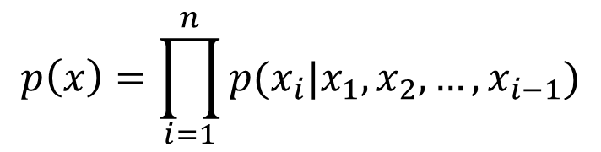
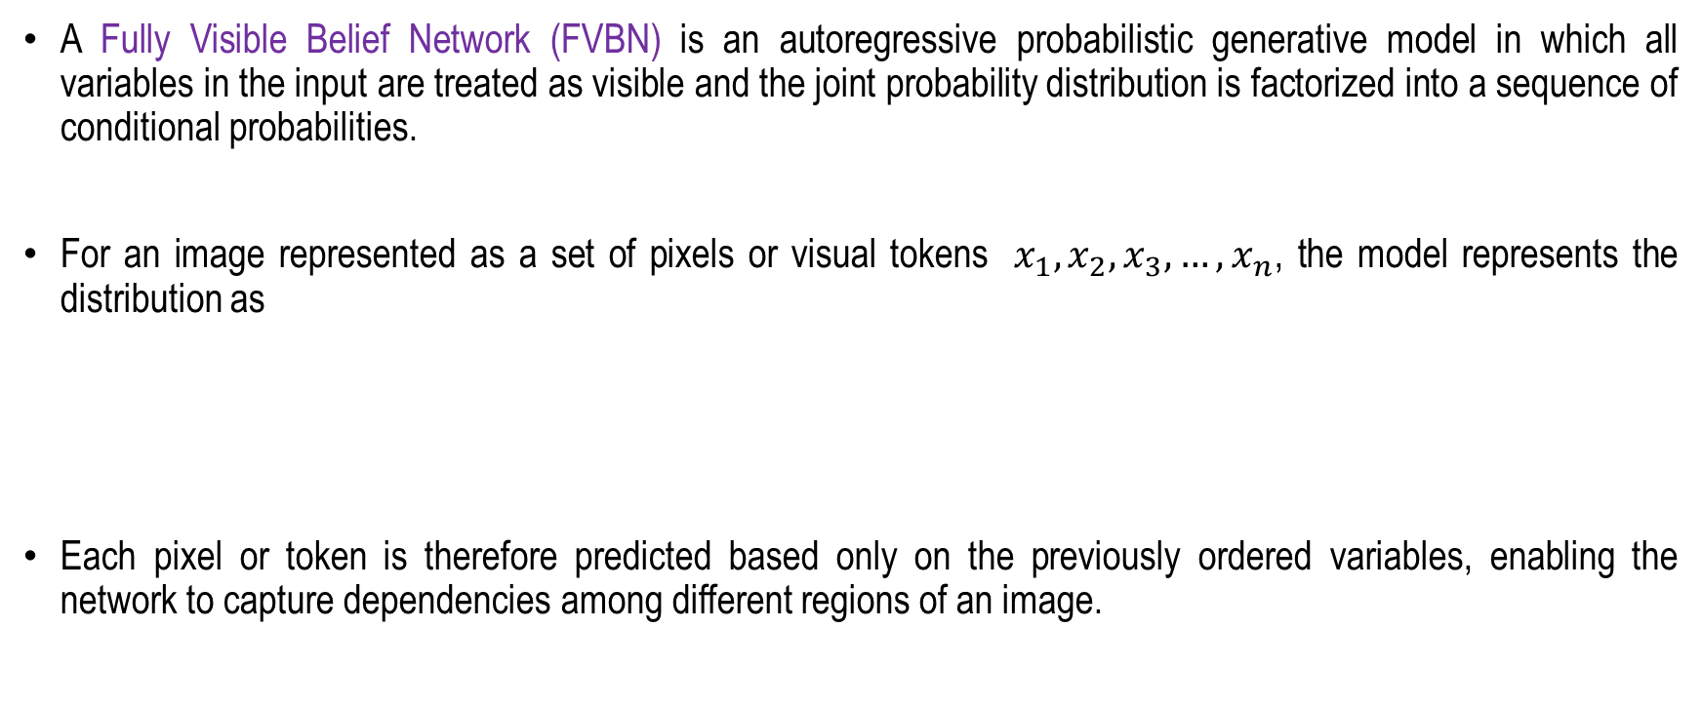
Fully Visible Belief Network (FVBN)
A Fully Visible Belief Network (FVBN) is an autoregressive probabilistic generative model in which all variables in the input are treated as visible and the joint probability distribution is factorized into a sequence of conditional probabilities.
For an image represented as a set of pixels or visual tokens $x_{1}, x_{2}, x_{3}, …, x_{n}$, the model represents the distribution as
Each pixel or token is therefore predicted based only on the previously ordered variables, enabling the network to capture dependencies among different regions of an image.
$$p\left(x\right)=\prod_{i=1}^{n}{p(x_{i}|x_{1}, x_{2}, …, x_{i−1})}$$

Slide 9
Fully Visible Belief Network (FVBN)
FVBNs are typically trained using maximum likelihood estimation, where the objective is to maximize the probability assigned to the training images.
During generation, pixels or tokens are sampled sequentially according to the learned conditional distributions.
Models such as PixelRNN and PixelCNN are prominent examples of this fully visible autoregressive approach.
Although FVBNs provide an explicit and tractable likelihood function and can model complex image distributions, their sequential sampling process can make image generation computationally expensive and relatively slow.

Slide 10

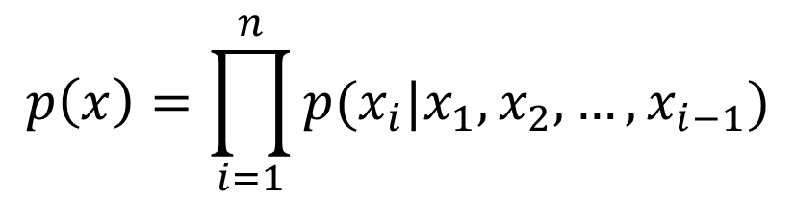


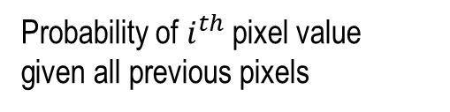
Fully visible belief network (FVBN)
This is an Explicit density model
The chain rule is used to decompose the likelihood of an data into product of distributions:
$$p\left(x\right)=\prod_{i=1}^{n}{p(x_{i}|x_{1}, x_{2}, …, x_{i−1})}$$
$$x_{1}$$
$$x_{i}$$
Likelihood of image x
Probability of $i^{th}$ pixel value
given all previous pixels
A neural network is used to realize the Complex pixel distribution.
The goal is to maximize the likelihood of training data
Concept: Fei-Fei Li et.al. CS 231n Deep Learning for Computer Vision

Slide 11
Examples of Autoregressive Models
Several famous AI models use autoregressive generation:
  PixelRNN and PixelCNN– image generation
  Transformer – widely used for sequence modelling
  GPT (Generative Pre‑trained Transformer) – text generation

Slide 12
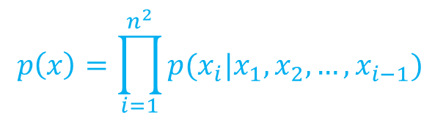
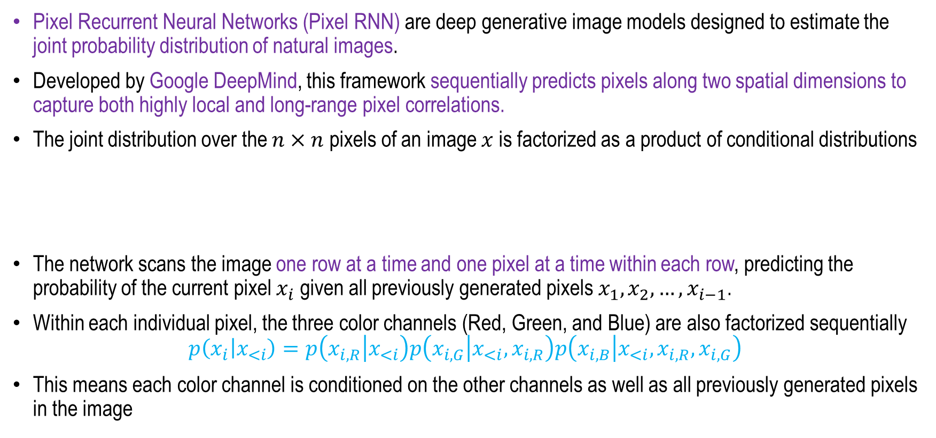
Pixel Recurrent Neural Networks
A¨aron van den Oord, Nal Kalchbrenner, Koray Kavukcuoglu, GOOGle Deep Mind, ICML 2016
Pixel Recurrent Neural Networks (Pixel RNN) are deep generative image models designed to estimate the joint probability distribution of natural images.
Developed by Google DeepMind, this framework sequentially predicts pixels along two spatial dimensions to capture both highly local and long-range pixel correlations.
The joint distribution over the $n×n$ pixels of an image $x$ is factorized as a product of conditional distributions
The network scans the image one row at a time and one pixel at a time within each row, predicting the probability of the current pixel $x_{i}$ given all previously generated pixels $x_{1}, x_{2}, …, x_{i−1}$.
Within each individual pixel, the three color channels (Red, Green, and Blue) are also factorized sequentially
$$p\left(x_{i} | x_{<i}\right)=p\left(x_{i,R} | x_{<i}\right)p\left(x_{i,G} | x_{<i},x_{i,R}\right)p\left(x_{i,B} | x_{<i},x_{i,R},x_{i,G}\right)$$
This means each color channel is conditioned on the other channels as well as all previously generated pixels in the image
$$p\left(x\right)=\prod_{i=1}^{n^{2}}{p(x_{i}|x_{1}, x_{2}, …, x_{i−1}) }$$
A¨aron van den Oord, Nal Kalchbrenner, Koray Kavukcuoglu, “Pixel Recurrent Neural Networks”, ICML 2016

Slide 13
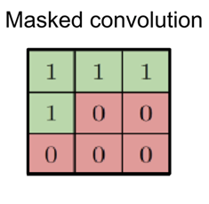
PixelCNN
PixelCNN: A simplified, fully convolutional alternative of fifteen layers that preserves spatial resolution and uses masked convolutions to capture a bounded receptive field.
While generation remains sequential, PixelCNN allows for complete parallelization of the pixel computations during training and evaluation
Masks are adopted in the convolutions to avoid seeing the future context;
A¨aron van den Oord, Nal Kalchbrenner, Koray Kavukcuoglu, “Pixel Recurrent Neural Networks”, ICML 2016

Slide 14
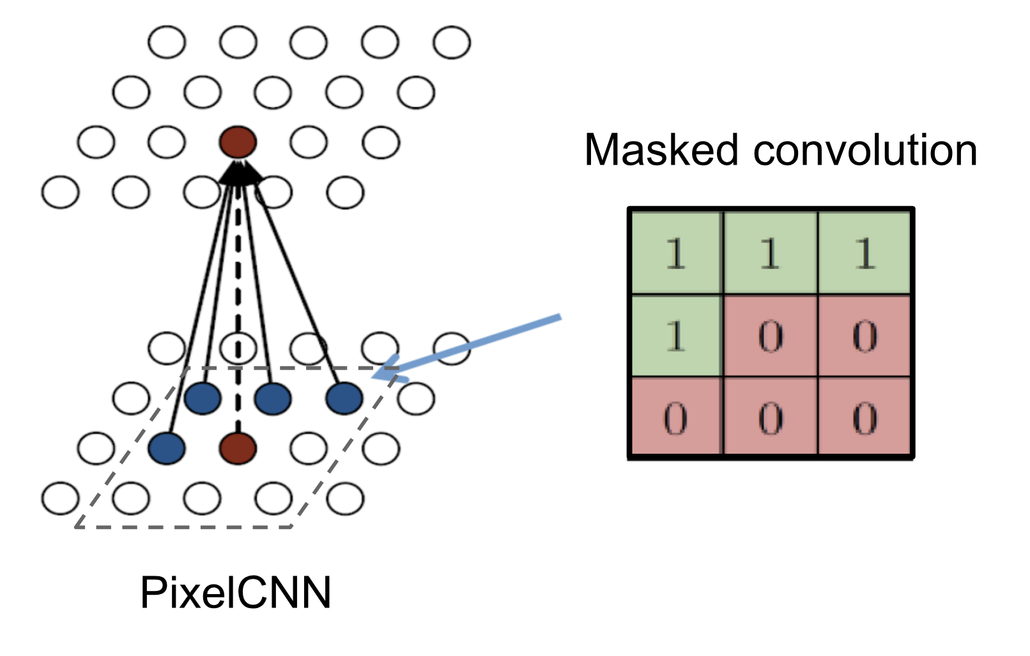
PixelCNN
Masked convolution in PixelCNN is a modified convolution operation used to ensure that when predicting a pixel, the model only uses information from previously generated pixels and not from future pixels.
In a standard convolution, the filter can access all neighboring pixels, which would violate the autoregressive property required for sequential image generation.
To solve this, PixelCNN applies a mask to the convolutional filters that sets certain weights to zero, blocking connections to future pixels (such as pixels to the right or below the current pixel).
This ensures that each pixel is predicted based only on pixels above and to the left.
A¨aron van den Oord, Nal Kalchbrenner, Koray Kavukcuoglu, “Pixel Recurrent Neural Networks”, ICML 2016

Slide 15
PixelRNN
Pixel by pixel is generated.
The process is started in general from the left top corner.
An RNN or LSTM is used to model the dependency on previous pixels for the current pixel.
PixelRNN treats an image as a sequence of pixels and predicts each pixel based on the pixels that come before it.
It generates an image by generating one pixel at a time.
A¨aron van den Oord, Nal Kalchbrenner, Koray Kavukcuoglu, “Pixel Recurrent Neural Networks”, ICML 2016

Slide 16
PixelRNN
Left: To generate pixel xi one conditions on all the previously generated pixels left and above of xi.
Center: To generate a pixel in the multi-scale case we can also condition on the subsampled image pixels (in light blue).
Right: Diagram of the connectivity inside a masked convolution. In the first layer, each of the RGB channels is connected to previous channels and to the context, but is not connected to itself.
In subsequent layers, the channels are also connected to themselves.
A¨aron van den Oord, Nal Kalchbrenner, Koray Kavukcuoglu, “Pixel Recurrent Neural Networks”, ICML 2016

Slide 17
PixelRNN Architectures
Row LSTM: A unidirectional layer that processes the image row by row from top to bottom using a 1D convolution.
This layer captures a roughly triangular context above the current pixel but is unable to capture the entire available context
A¨aron van den Oord, Nal Kalchbrenner, Koray Kavukcuoglu, “Pixel Recurrent Neural Networks”, ICML 2016

Slide 18
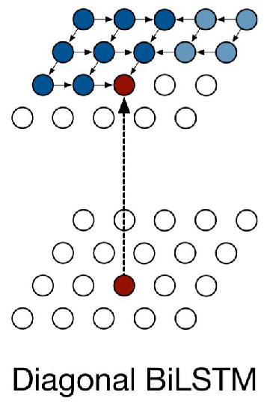
PixelRNN Architectures
Diagonal BiLSTM: Designed to capture the entire available global context.
It skews the input map by offsetting each row by one position to parallelize calculations along diagonals, utilizing a highly nonlinear 2×1 state-to-state convolution.
A¨aron van den Oord, Nal Kalchbrenner, Koray Kavukcuoglu, “Pixel Recurrent Neural Networks”, ICML 2016

Slide 19
Comparison between the 3 variants
A¨aron van den Oord, Nal Kalchbrenner, Koray Kavukcuoglu, “Pixel Recurrent Neural Networks”, ICML 2016

Slide 20
PixelRNN Applications
Image generation
Density estimation for images
Image completion / inpainting
Lossless image compression
Figure: Fei-Fei Li et.al. CS 231n Deep Learning for Computer Vision

Slide 21
PixelRNN Drawbacks
Very slow generation (pixel-by-pixel)
Computationally expensive
Hard to scale to very large images
Concept: Fei-Fei Li et.al. CS 231n Deep Learning for Computer Vision

Slide 22
Visual Results
Samples from models trained on CIFAR-10
Samples from models trained on ImageNet 32x32
A¨aron van den Oord, Nal Kalchbrenner, Koray Kavukcuoglu, “Pixel Recurrent Neural Networks”, ICML 2016

Slide 23
Summary
Autoregressive Model
Fully Visible Belief Network (FVBN)
Pixel CNN
Pixel RNN

Slide 24
Transformers
Next
Lecture 8: Part 3
Generative AI for Computer Vision

